Slide 1
Analysis of Student Performance Predictions
Skills Takeaway: Python coding, Data Pre-processing, Visualization, Feature Engineering, Model Evaluation,
By: Juliet
OESON Learning

Slide 2
Introduction
The aim of this analysis is to predict student performance using machine learning models.
We will explore different models and evaluate their performance.

Slide 3
Dataset Overview
The dataset contains various features related to student information and performance.
Features include marital status, application mode, previous qualifications, nationality, parental qualifications, occupation, financial status, etc.

Slide 4
Data Analysis
We performed exploratory data analysis to understand the relationships between different features.
Visualizations such as count plots were used to visualize the distribution of features and their relationship with the target variable.

Slide 5
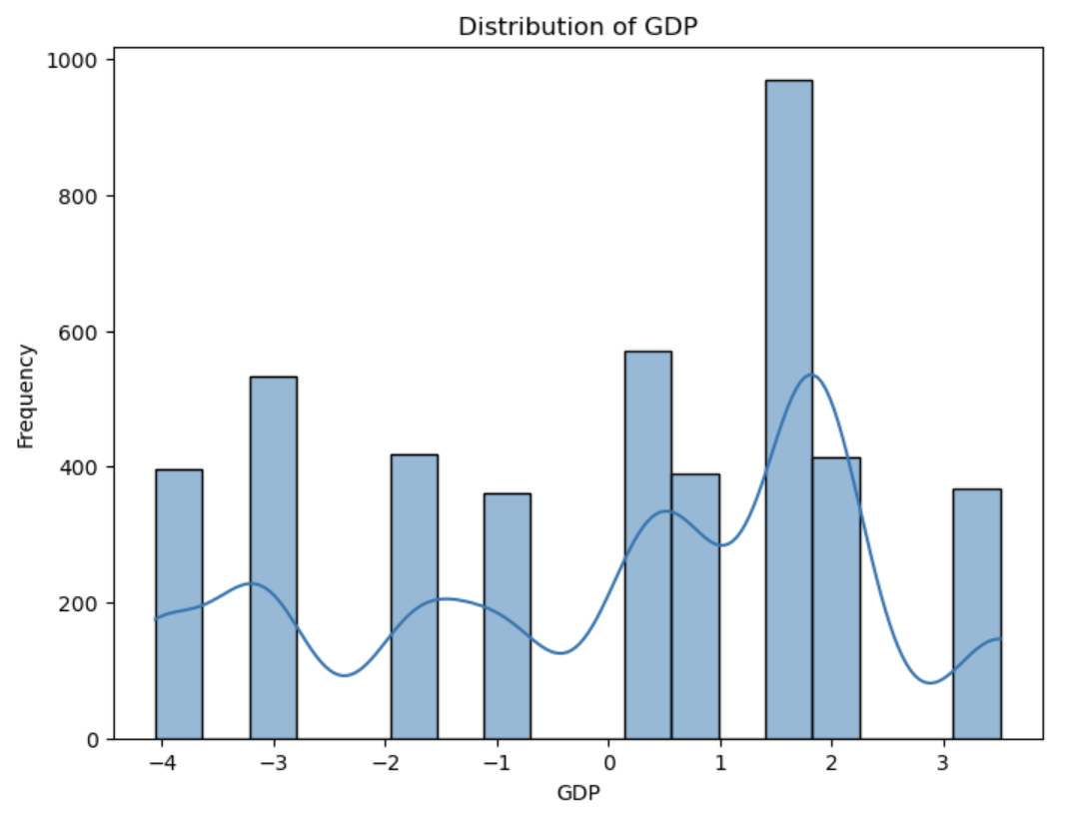
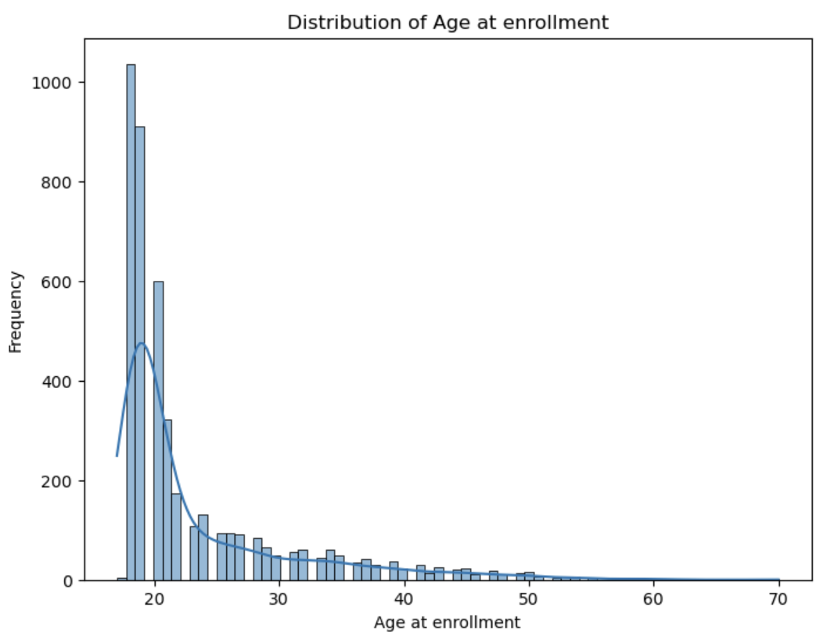
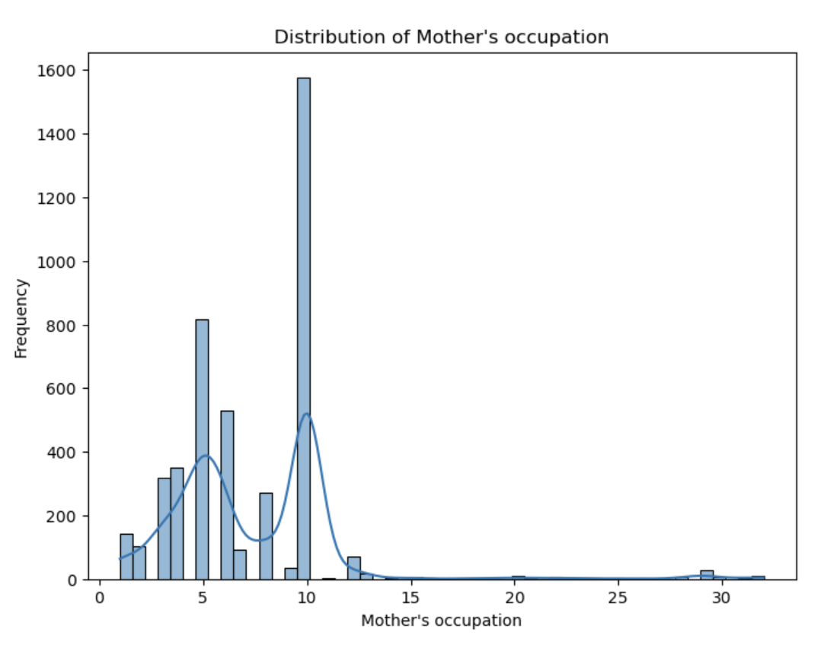
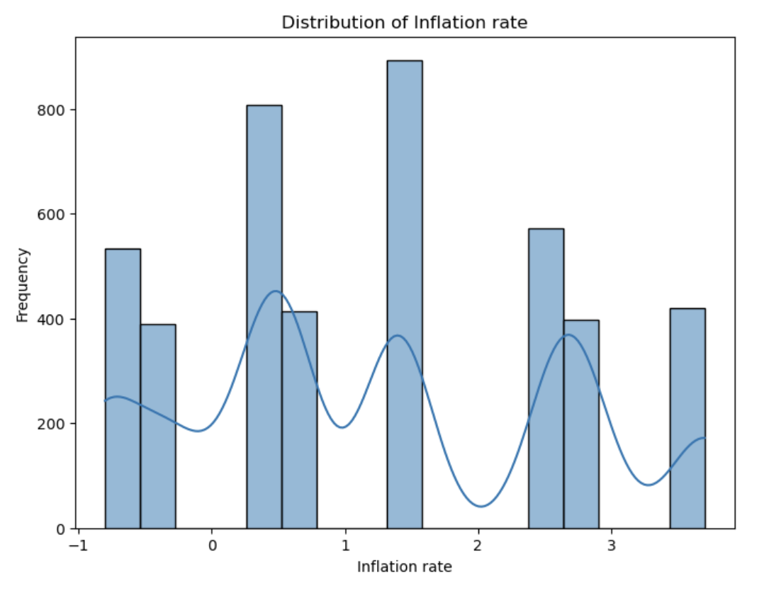
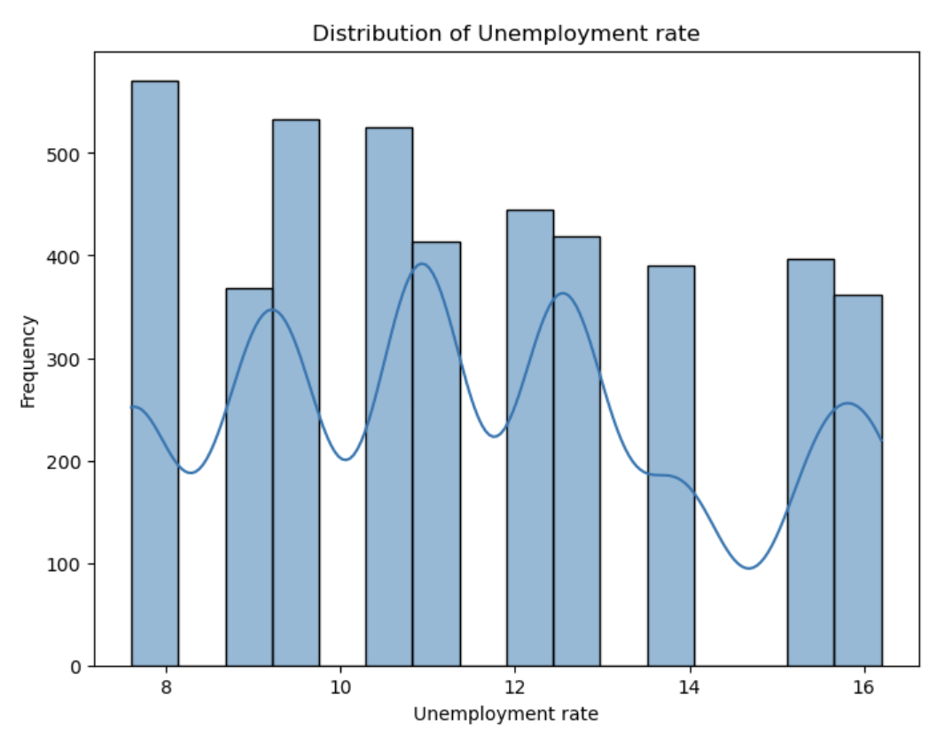
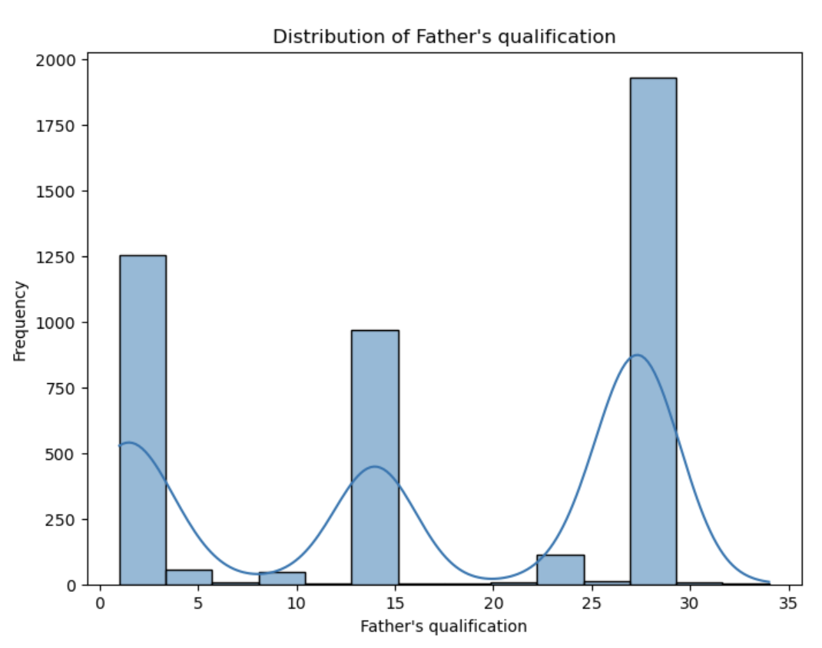
Univariate Analysis

Slide 6
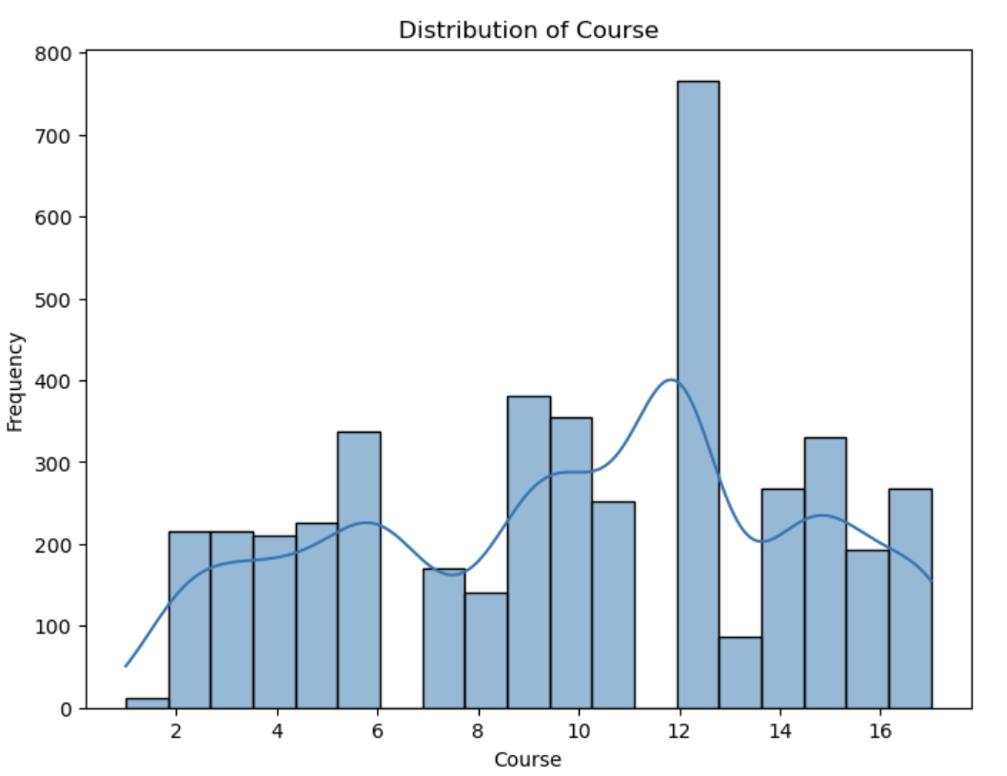
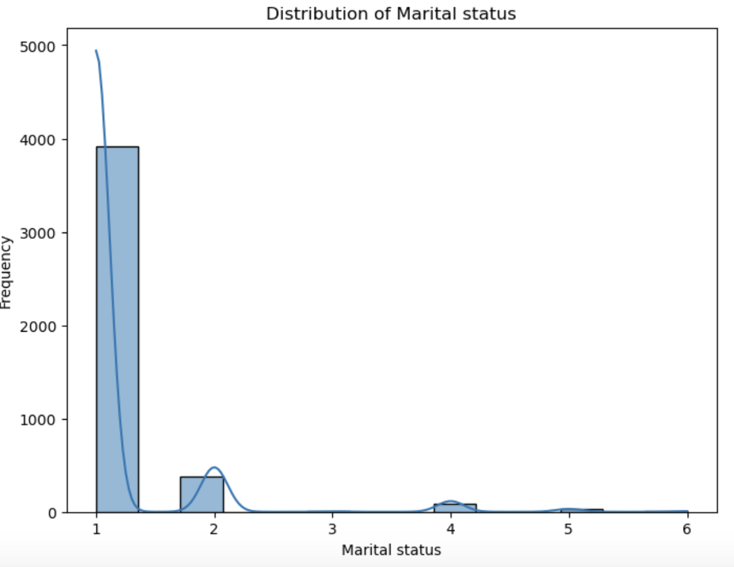
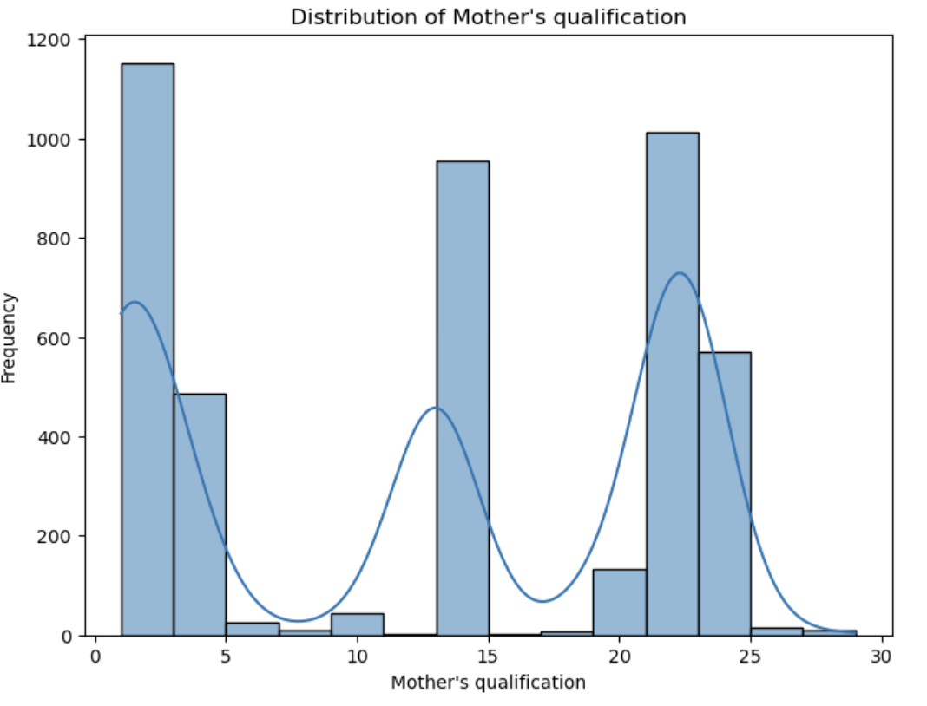
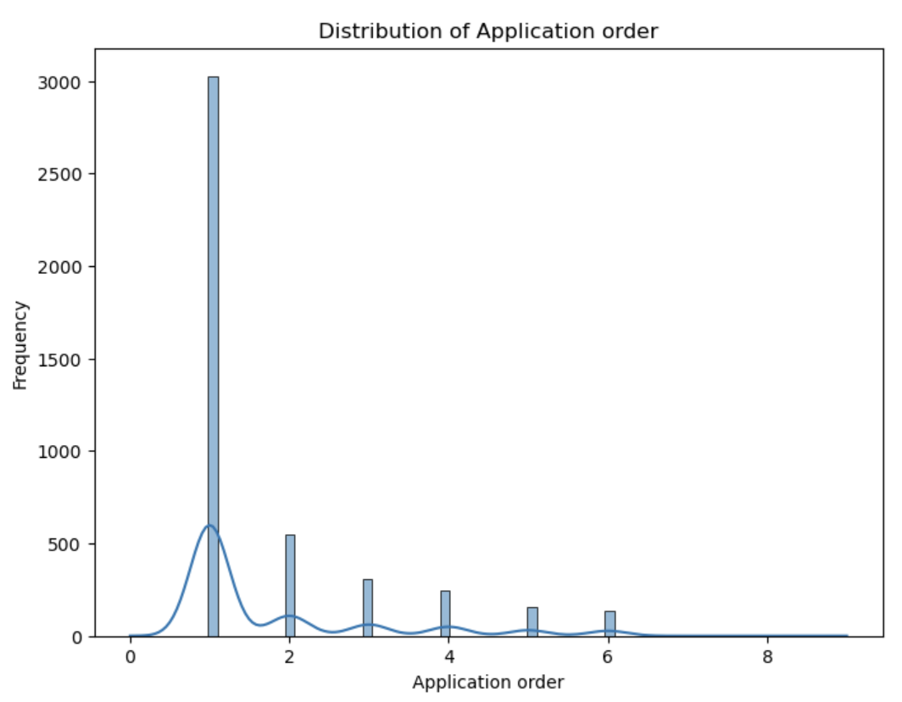
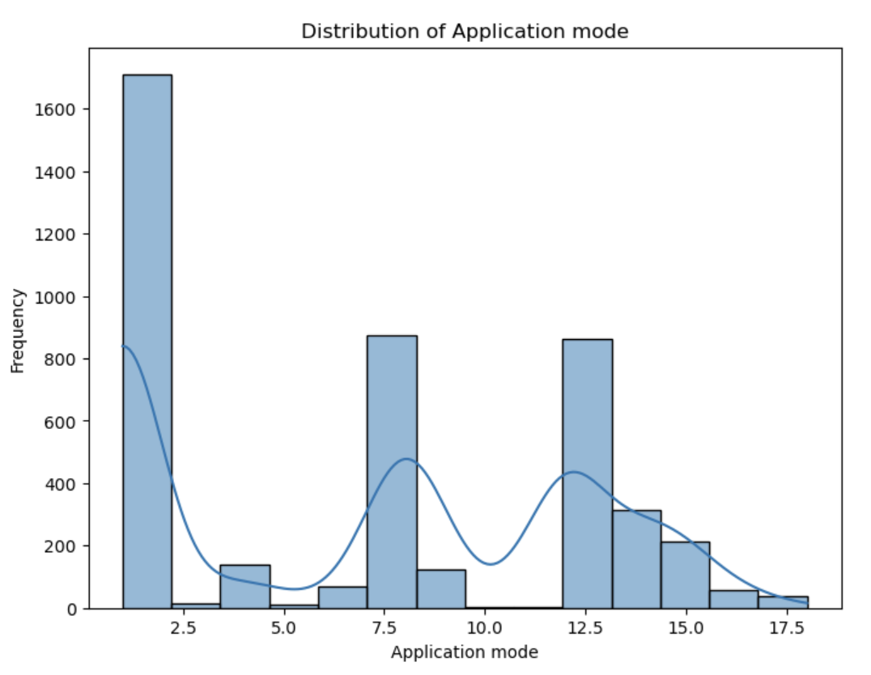
Univariate Analysis

Slide 7
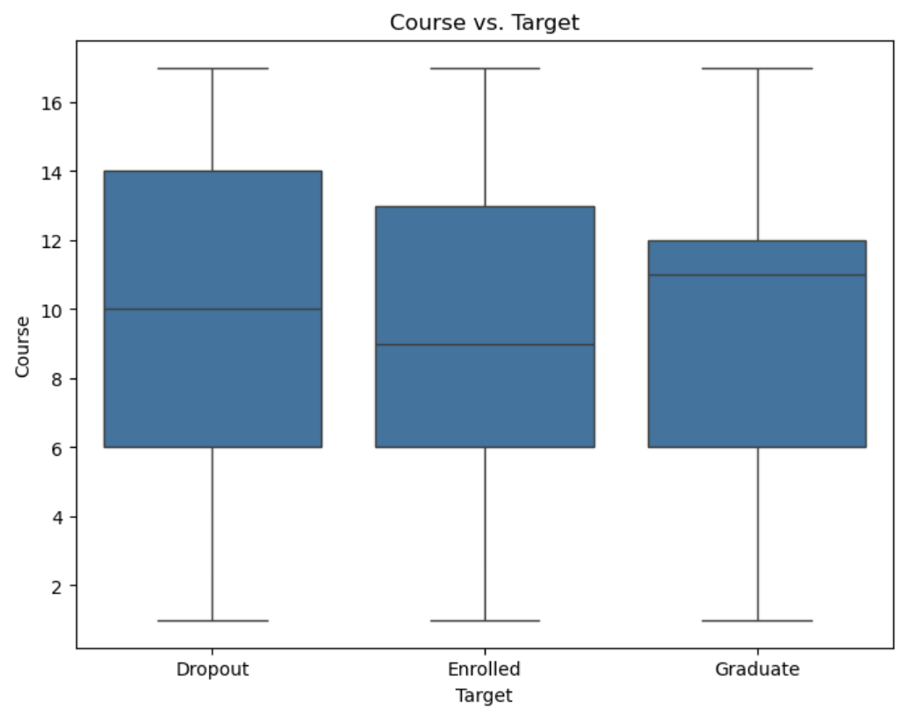
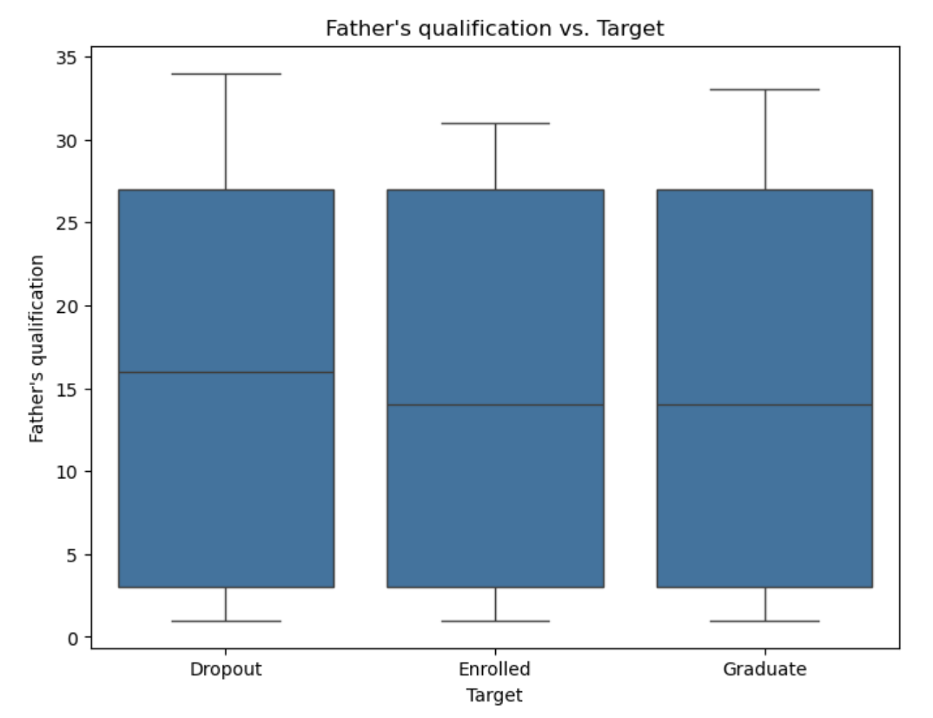
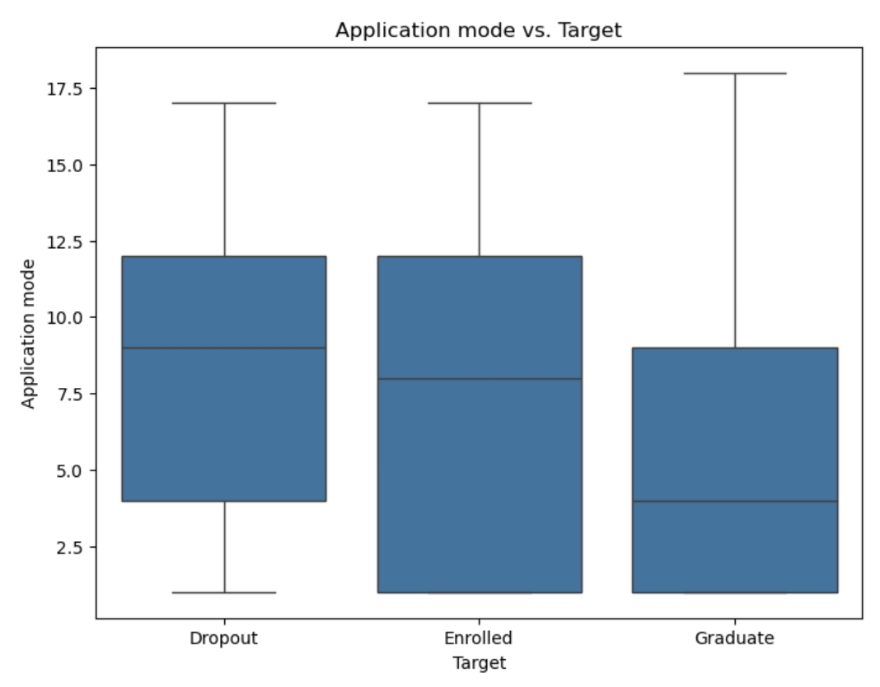
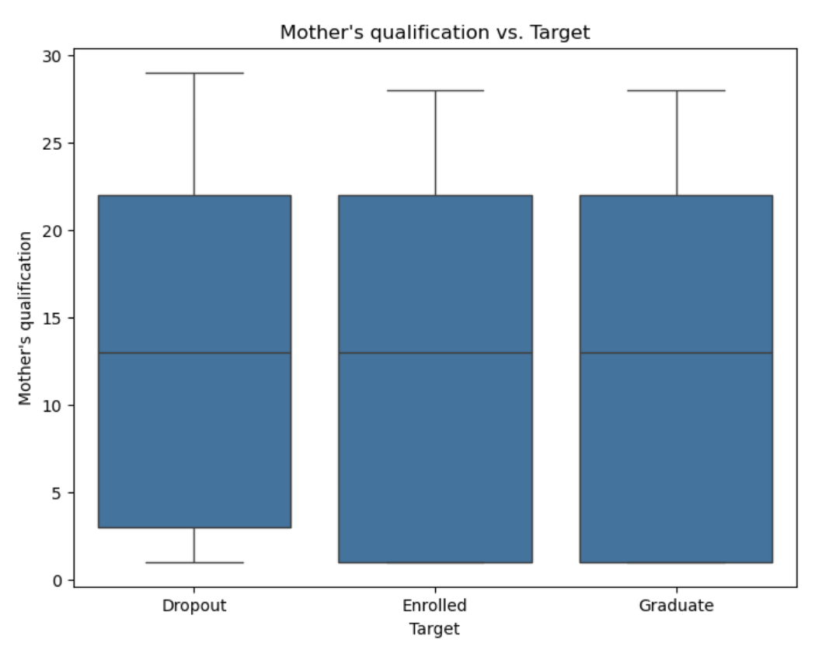
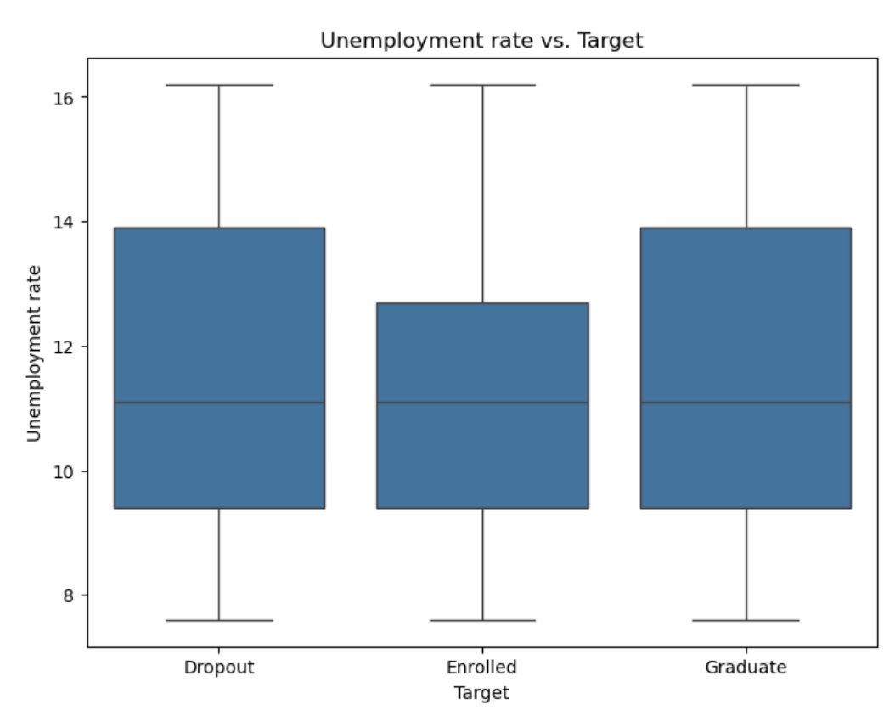
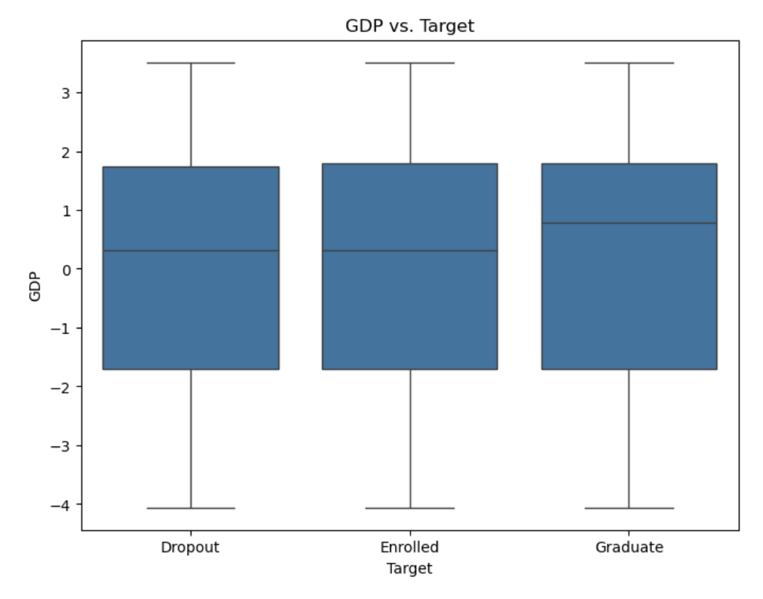
Bivariate Analysis

Slide 8
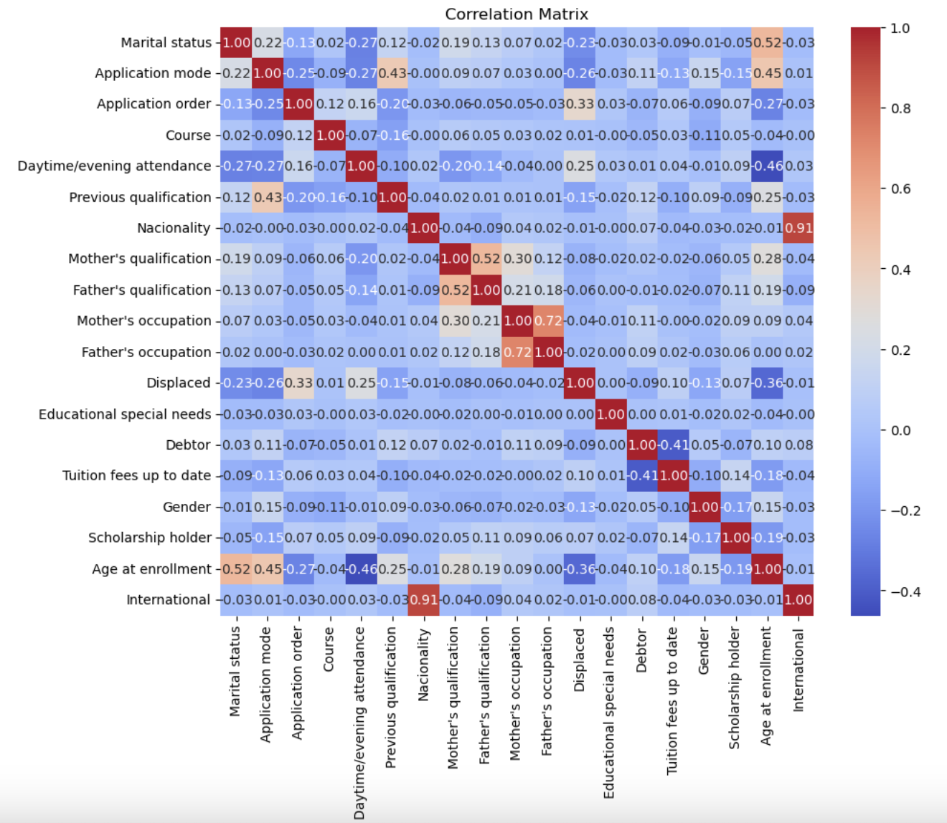
Correlation Matrix

Slide 9
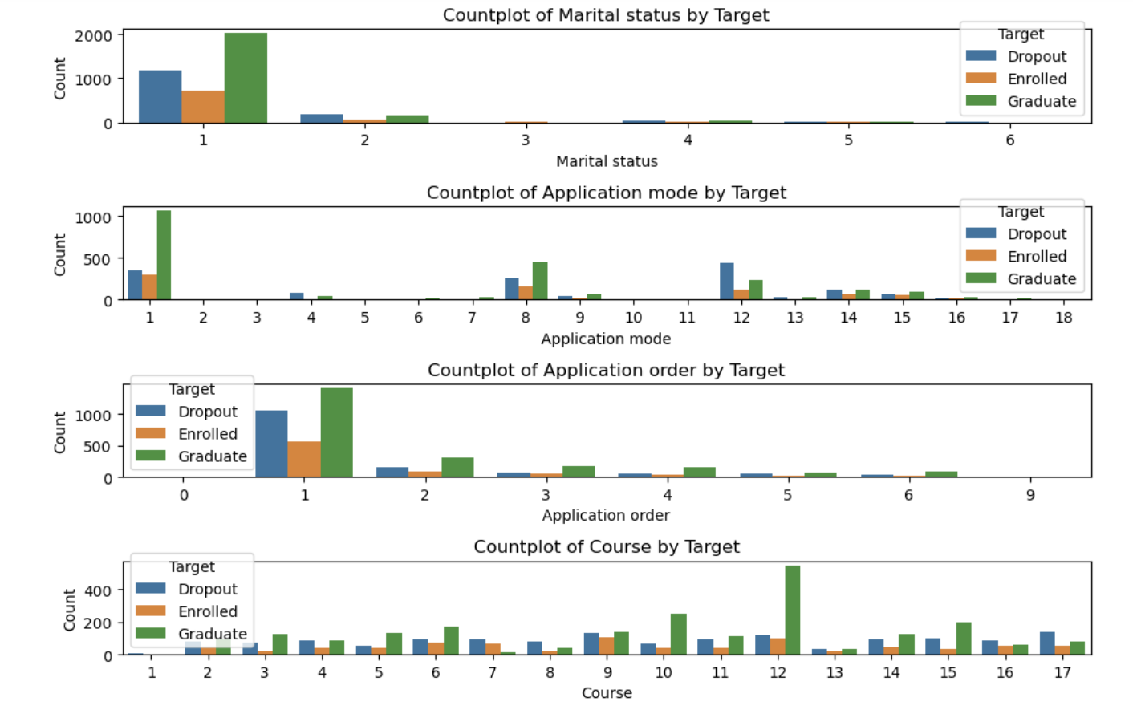
Relationship between target and other features

Slide 10
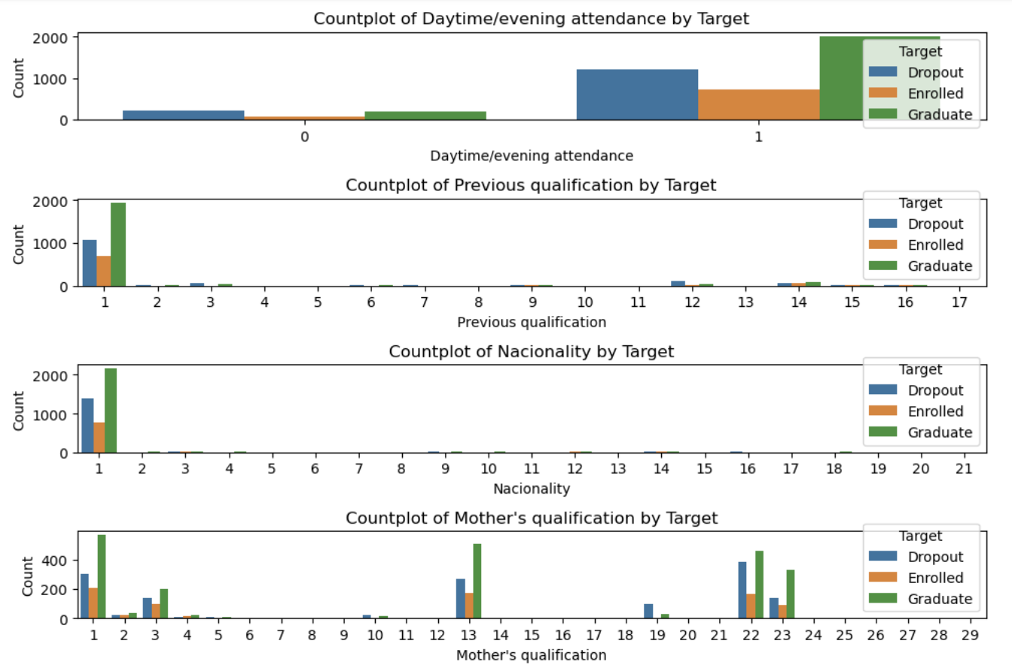
Relationship between target and other features

Slide 11
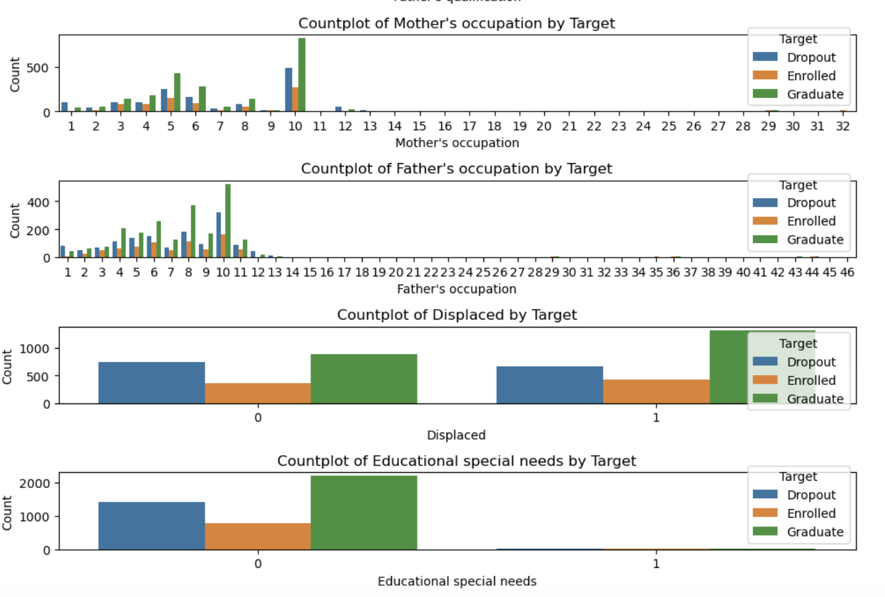
Relationship between target and other features

Slide 12
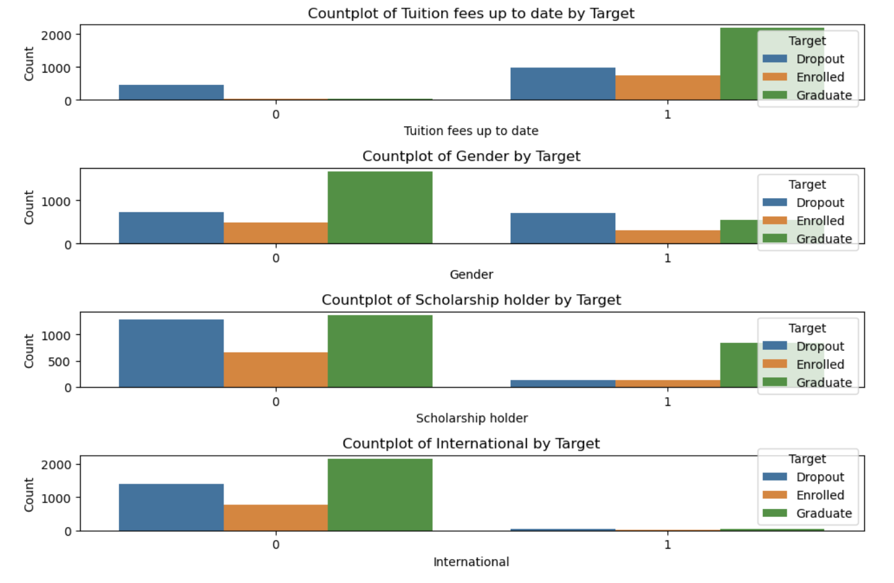
Relationship between target and other features

Slide 13
Model Evaluation
We evaluated several machine learning models:
Logistic Regression
Decision Tree
Random Forest
Support Vector Machine (SVM)
K-Nearest Neighbors (KNN)
Each model was trained and tested on the dataset, and its performance was evaluated using accuracy scores, classification reports, and confusion matrices.

Slide 14
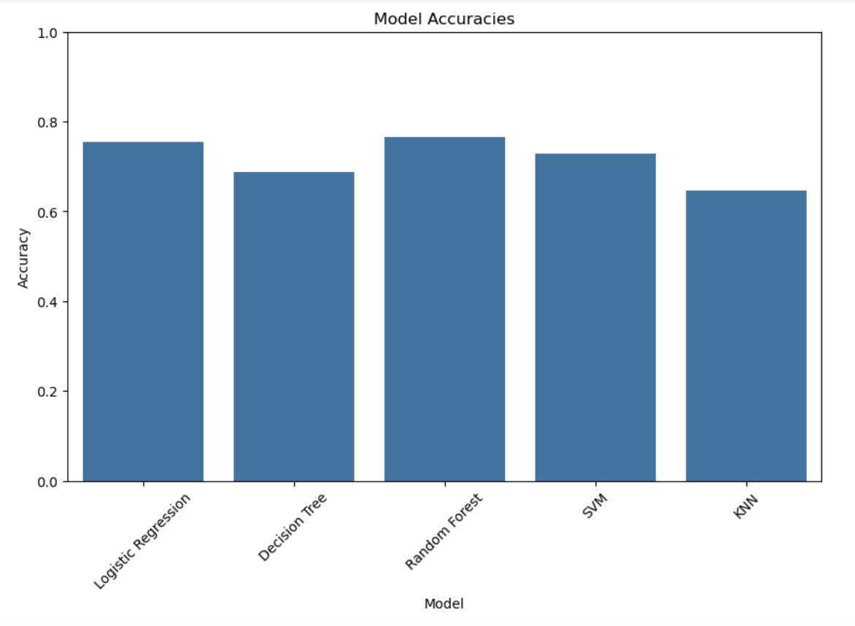
Model Evaluation

Slide 15
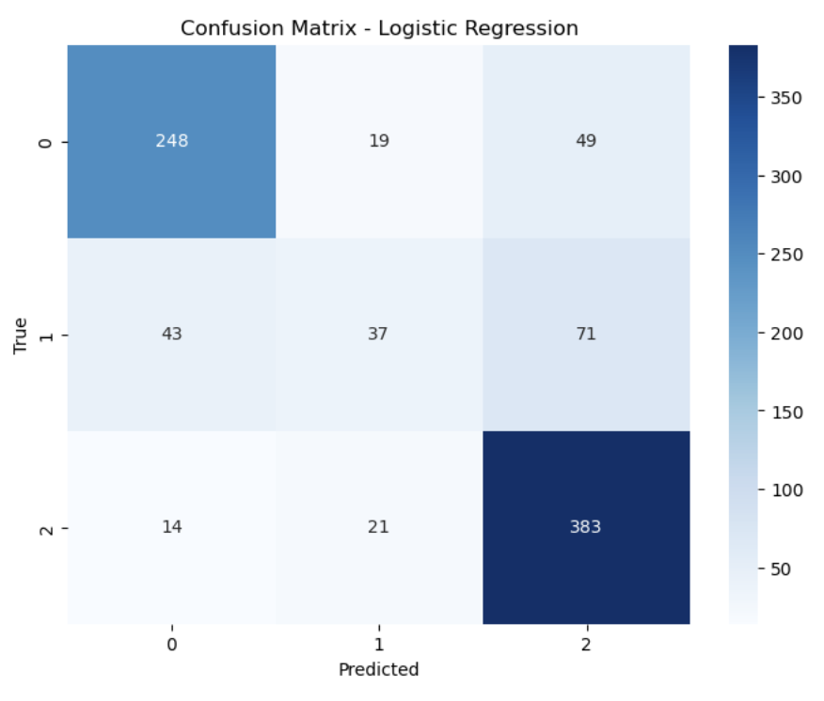
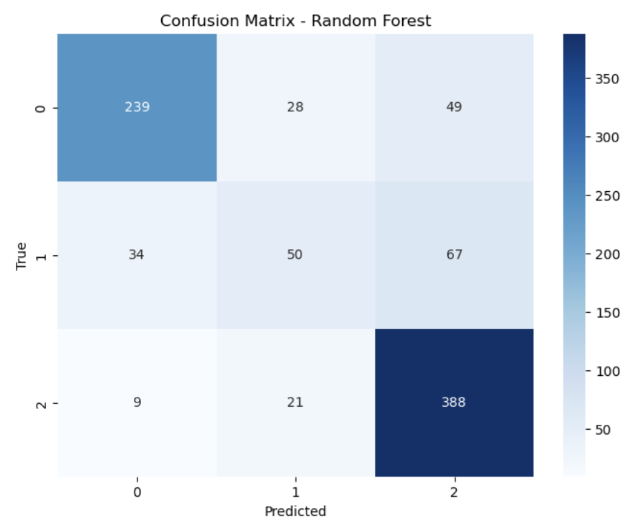
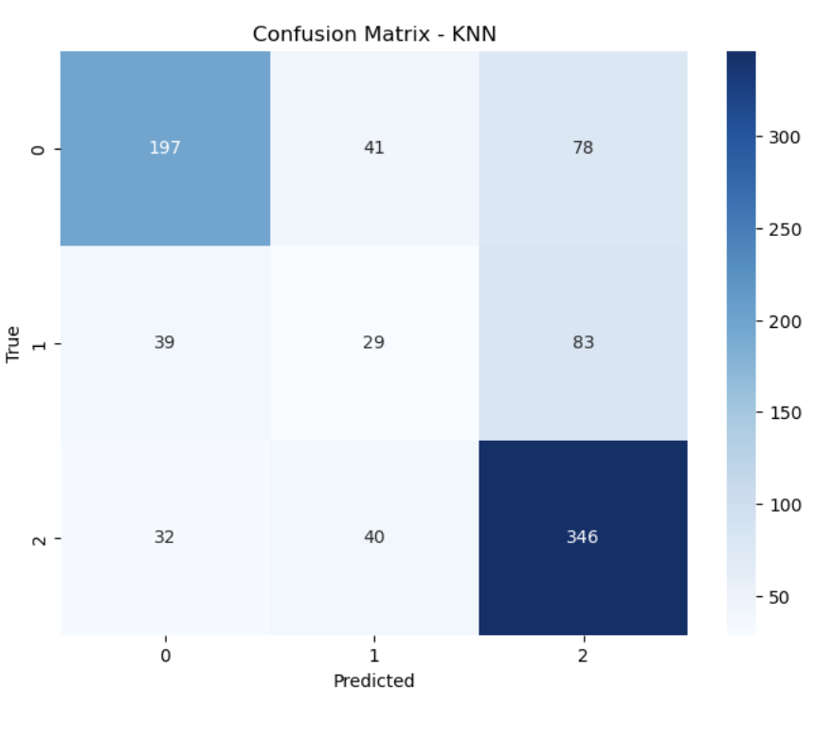
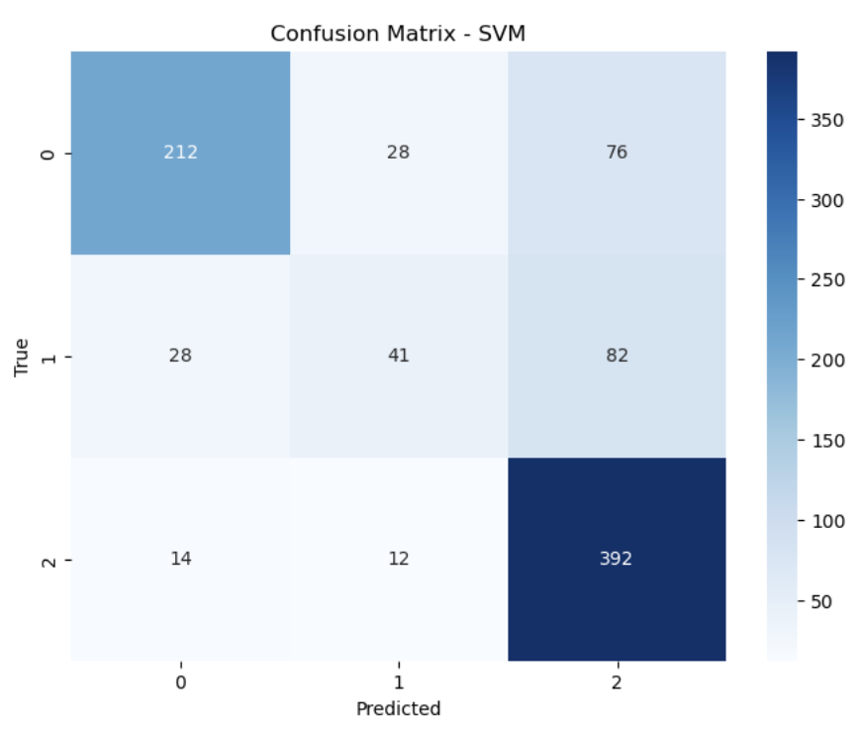
Confusion Matrix

Slide 16
THANKS!

